Slide 1
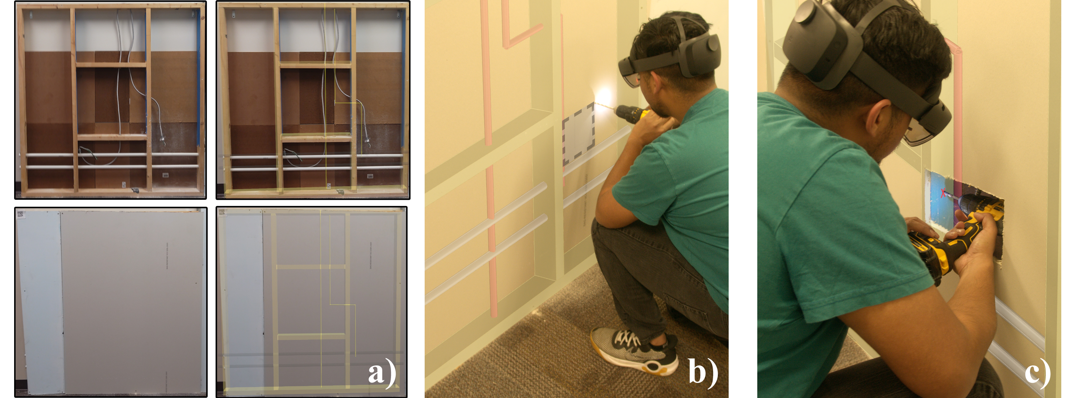
BIM-enabled AR Retrofit Training [WORKING TITLE]
ISMAR2023
Submission ID: 1015

Slide 2
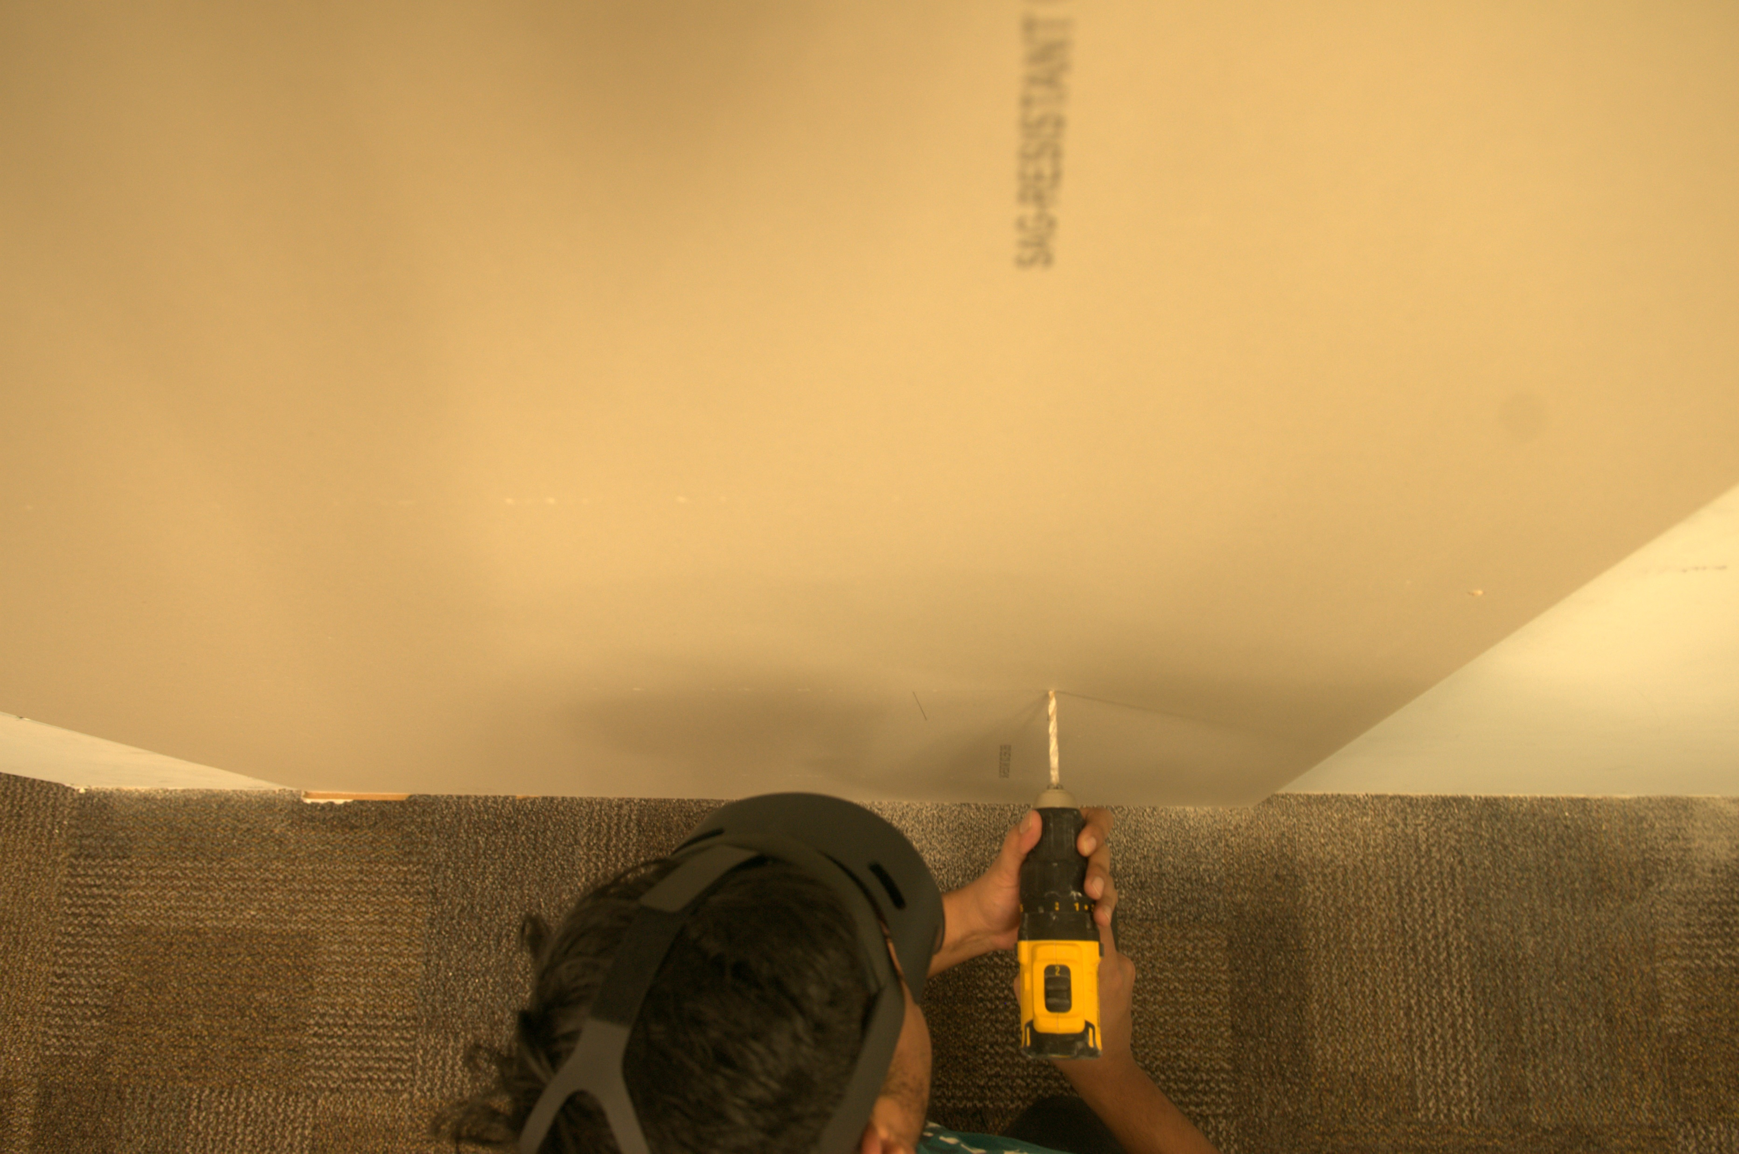


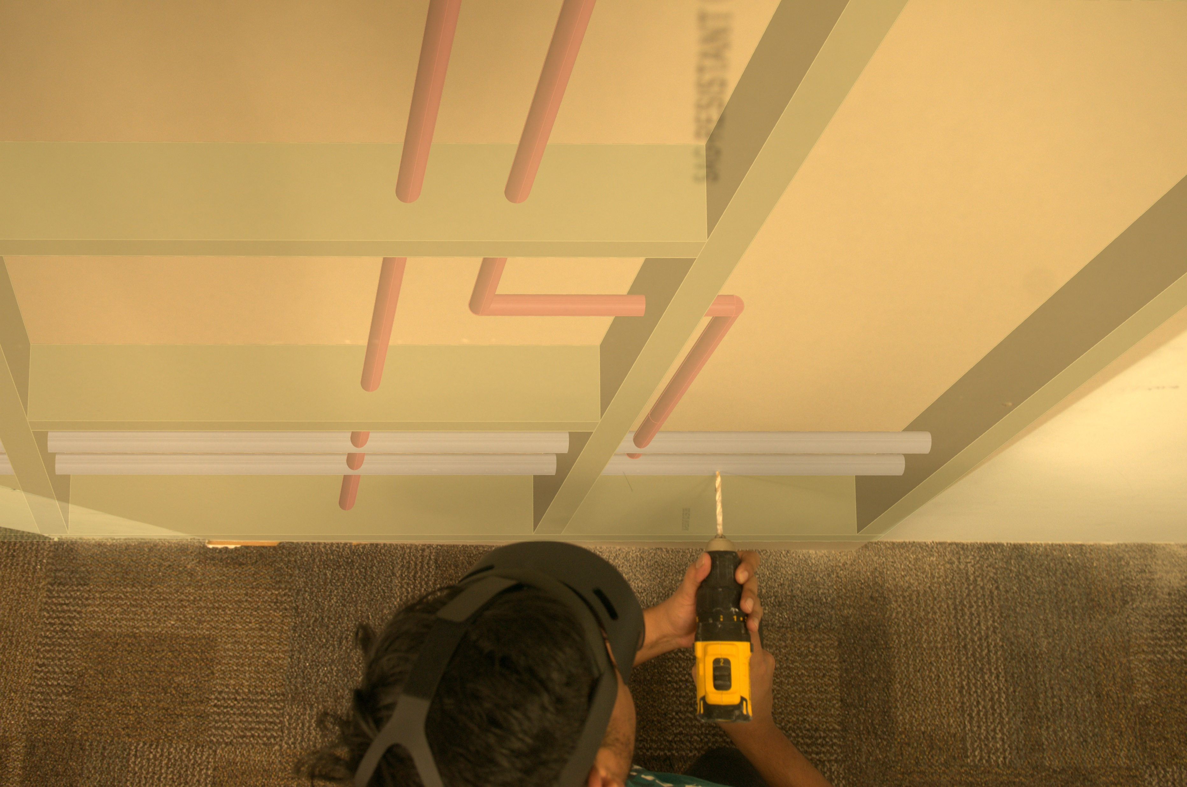
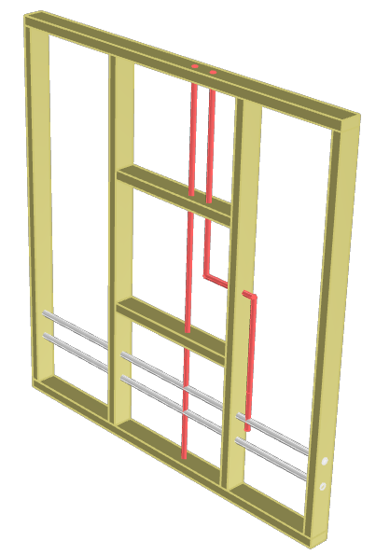
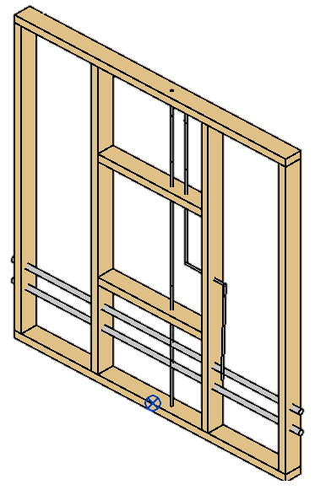
Premise
Augmenting and displaying BIM data during retrofitting training
Retrofitting
Building Information Modeling
Augmented Reality

Slide 3
Study Design
“What are they doing?”
Groups

Slide 4
Hypotheses

Slide 5
Measures

Slide 6
Results

